Slide 1
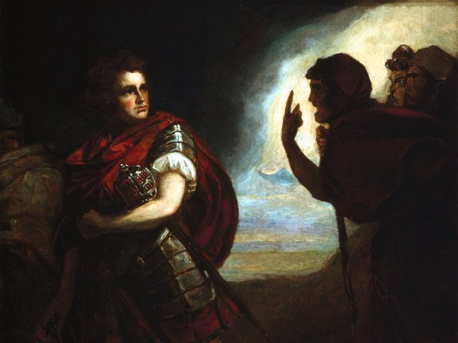
The Tragedy of Macbeth
Lesson 7-Act 3, Scenes 1-3

Slide 2
Activator- Banquo’s Thoughts

Slide 3
Matching Game-Banquo’s Thoughts
Thou hast it now—king, Cawdor, Glamis, all
As the Weïrd Women promised, and I fear
Thou played’st most foully for ’t. Yet it was said
It should not stand in thy posterity,
But that myself should be the root and father
Of many kings. If there come truth from them
(As upon thee, Macbeth, their speeches shine)
Why, by the verities on thee made good,
May they not be my oracles as well,
And set me up in hope? But hush, no more.

Slide 4
Matching Game-Answers
Now you have it all- King, Cawdor, Glamis
Just like the witches said you would, but I’m afraid
That you did something very evil to get it. Yet it was said
That it will not last long
And that I will be the source and father
Of many kings. If the witches tell the truth
As they have for told truths for Macbeth
Why, since they have already proven to be true
Would my prophecies not come true as well
And leave me hoping? Be quiet, I’ll speak no more about this.
Thou hast it now—king, Cawdor, Glamis, all
As the Weïrd Women promised, and I fear
Thou played’st most foully for ’t. Yet it was said
It should not stand in thy posterity,
But that myself should be the root and father
Of many kings. If there come truth from them
(As upon thee, Macbeth, their speeches shine)
Why, by the verities on thee made good,
May they not be my oracles as well,
And set me up in hope? But hush, no more.

Slide 5
Activity 1- Close Reading 3.1

Slide 6
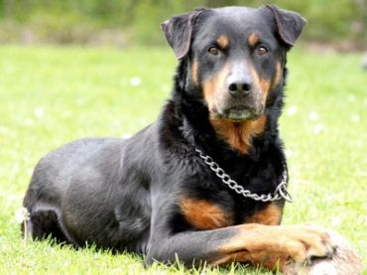
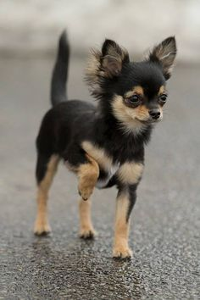
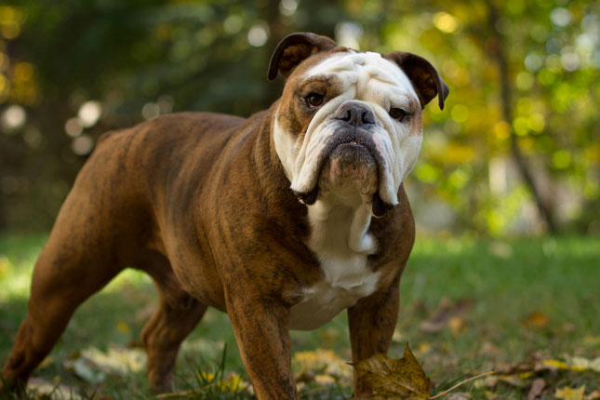
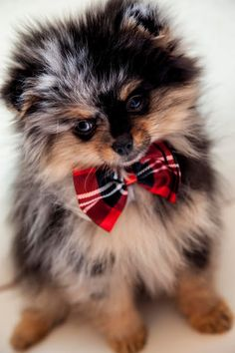
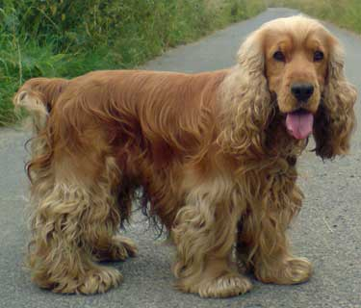
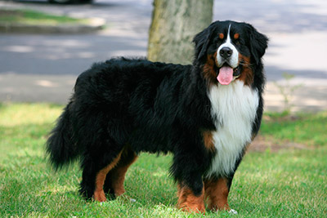
Are all of these the same?

Slide 7
Questions:
How does Macbeth convince the murderers to kill Banquo?
What has Macbeth learned about manipulation from Lady Macbeth?

Slide 8
Activity 2-Close Reading 3.2

Slide 9
Translations in Groups

Slide 10
Activity 3- Close Reading of 3.3

Slide 11
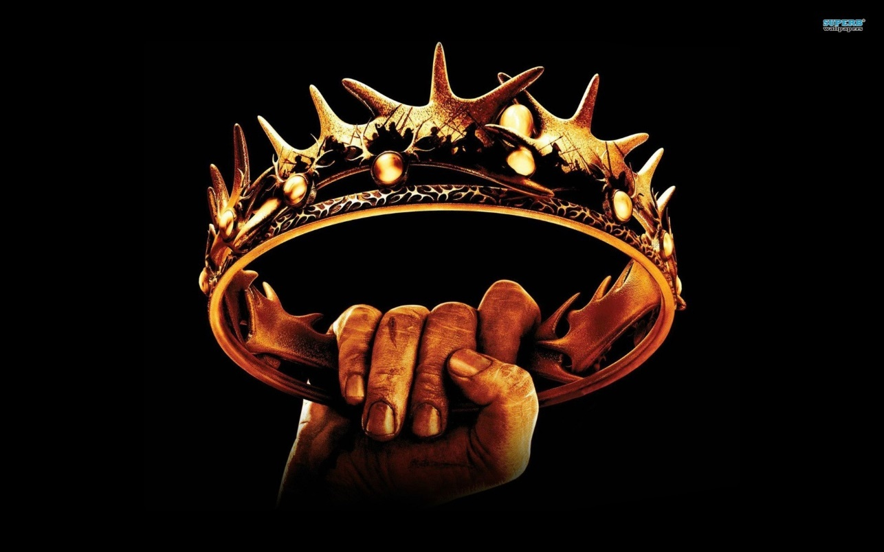
What is dangerous about Fleance escaping?

